Slide 1

Week 2 Practical: Hill and Playfair Cipher
CT5046 Cryptography and Security
University of Gloucestershire

Slide 2
Overview
Recap
Hill cipher
Playfair cipher
Bringing it all together
Post-sessional work

Slide 3
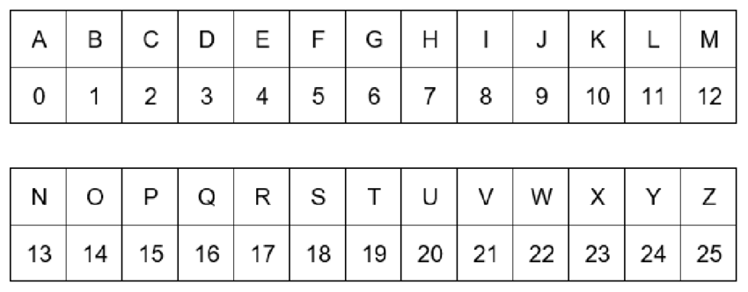
Alphabet index

Slide 4
Recap
Last week, we established that classical ciphers can be classified into:
Substitution ciphers
Polygraphic ciphers
We looked at Caesar and Vigenère ciphers as examples of:
Substitution ciphers
This week we will look at Hill cipher and Fairplay cipher

Slide 5
Hill Cipher

Slide 6
Hill Cipher overview
Created by Lester S. Hill in 1929
Polygraphic Cipher
Uses matrices to encrypt and decrypt
Uses modular arithmetic (Mod 26)

Slide 7
Modular arithmetic recap
Given two numbers a and b, a modular operation takes the
remainder/modulo of a division operation on a by b
Denoted by mod
r = a mod b
For example,
0 mod 26 = 0
10 mod 26 = 10
27 mod 26 = 1
30 mod 26 = 4

Slide 8
How it works
One matrix to encrypt, one to decrypt
Must be n × n, invertible matrices
Decryption matrix must be modular inverse of encryption matrix in mod 26

Slide 9
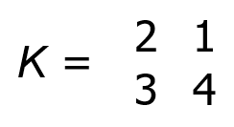
Example
Suppose that we have a key matrix K:
To encrypt plaintext P = CRYPTO

Slide 10
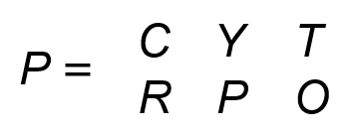
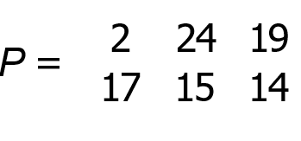
Example
Step 1: Organise plaintext into a matrix
Step 2: Convert each character into their corresponding indices

Slide 11
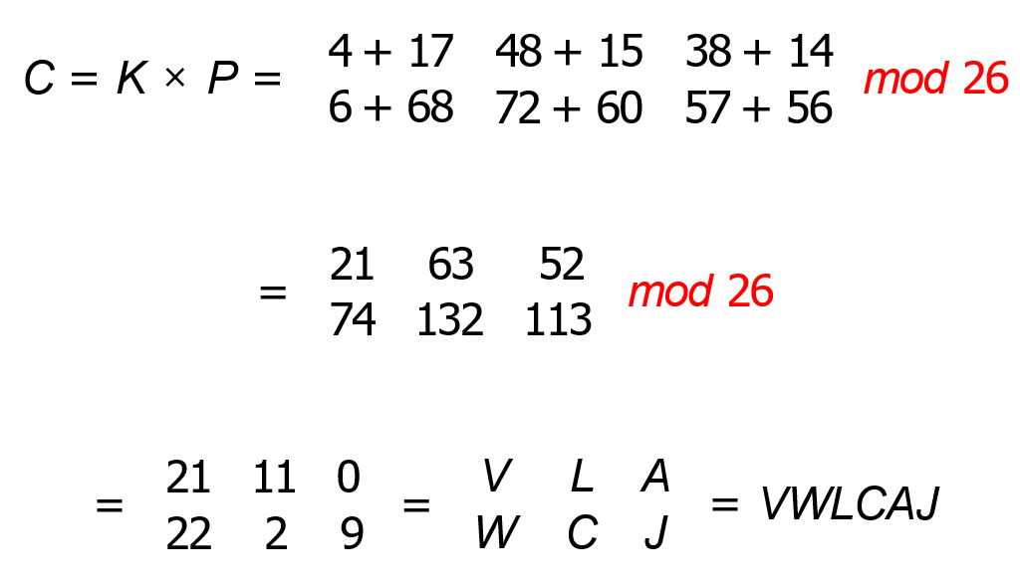
Example
Step 3: Multiply with key matrix K to get ciphertext C :

Slide 12
Decryption
Now that we have got our ciphertext C together with key K , decrypting it is pretty straightforward
It is done by using this equation
P = (K⁻¹ × C ) mod 26
But first we have to get the inverse of K (i.e., K⁻¹), using what we discussed in the lecture slides
But we need to get two things first:
Determinant of K det(K)
modulo inverse M of det(K)

Slide 13
Modulo inverse
The modulo inverse M of an integer A is an integer A⁻¹ such that
AA⁻¹ mod m = 1
So, for instance the modulo inverse of 9 with respect to 26 would be 3, since
(9 × 3) mod 26 = 1

Slide 14
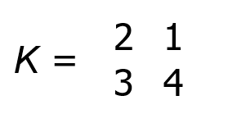
Example: Decryption
Given the matrix K
Step 1: Get the determinant det(K )
M = det(K ) = 2 × 4 − 3 × 1 = 5
Step 2: Get the modulo inverse M⁻¹ of M with respect to 26, which would be 21 since
(5 × 21) mod 26 = 1

Slide 15
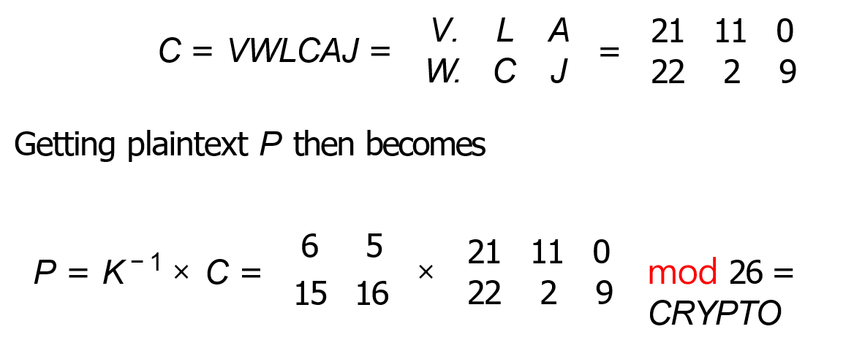
Example: Decryption
Step 3: With ciphertext

Slide 16
Hill Cypher on CrypTool 2
From the CryptTool 2 startup menu, click Cryptography
Then click Classical and then select Hill cipher
In the plaintext section of TextInput, type in: roses are red
Then in the Hill cipher box, type in a 2 x 2 matrix of your choice

Slide 17
Playfair Cipher

Slide 18
Overview of Playfair Cipher
Invented by Charles Wheatstone in 1854 Encrypts two letters at a time
Features a 5 × 5 matrix of letters based on a keyword
Fill in letters of keyword (sans duplicates)
Fill rest of matrix with other letters

Slide 19
Rules
If a pair is a repeated letter, insert a filler like “X”. E.g., “hallway” would become ha lx wa yx
If both letters fall in the same row, replace each with letter to right.
If both letters fall in the same column, replace each with the letter below it (again wrapping to top from bottom)
Otherwise each letter is replaced by the one in its row in the column of the other letter of the pair

Slide 20
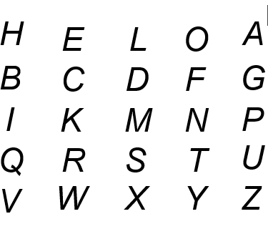
Example
Given the keyword K =“HELLO” and plaintext P =“CRYPTO”, Step 1: Arrange K into a 5 × 5 matrix, making it like so:
Step 2: Break down P into two letter pairs, like so: CR YP TO

Slide 21
Example
Step 3: Encrypt each pair using the 4 rules and the key matrix, so
CR −→ KW
YP −→ ZN
TO −→ YF
Step 4: The encrypted ciphertext C then becomes: KWZNYF

Slide 22
Playfair Cipher on CryptTool 2
From the CryptTool 2 startup menu, click Cryptography
Then click Classical and then select Playfair cipher
In the plaintext section of TextInput, type in: CRYPTO
Next double-click on the Playfair cipher box to open up its settings
Then type in HELLO in the Key Value
Finally minimize it and click on the Play button to execute

Slide 23
Exercise
Create a CryptTool project which accepts a plaintext, and:
First encrypts it using Hill Cipher
Then encrypts the Hill Cipher with Playfair Cipher
Then gets the original plaintext back to its original form

Slide 24
Recap
We looked at both Hill and Playfair ciphers
We also looked at how each of them works and how to get them working in CrypTool 2
Next week: Information theory and classical ciphers

Slide 25
Q&A

